Slide 1
PHASE 5: ANALYSIS ON NYC ILLEGAL REVENUES
By - Abul Hasan Fazulullah
UBID# 1011913
Siddharth Selvam
UBID# 1031196

Slide 2
INTRODUCTION -
The terms quality, luxury and life style goes hand in hand when we say New York city.
Though the city is small in terms of area , it does not make it hard for it to be in the third spot for the most expensive city to live in USA.
Most expensive area: Manhattan Average home price: $1,621,965 Average rent: $3,783 Half gallon of milk: $2.72 T-bone steak: $14.30 Monthly energy bill: $232.72 Doctor visit: $105.00
What the surprising part here is that , most of the residents of the NYC don’t know much about the expenses in the city.
The power of the NYC is with their top – notch finance department. They know how to make the city run even during the nights.
How do they run the city and what is their source of income ?
Fact - Comparing to Connecticut, New York is 65% more expensive.

Slide 3
PURPOSE -
The money that is being generated by the NYC is of two ways one being the visible money and the other being the dark money.
We love the dark side and our major concern is with the dark money that the NYC makes out of the New Yorkers with out their knowledge.
The main aim of this project is to showcase the illegal ways in which new York city makes money to run the city.
The following are the references, that aid us to prove our statement –
https://www.inverse.com/article/15564-how-new-york-city-s-open-data-revealed-the-nypd-was-issuing-illegal-parking-tickets
http://iquantny.tumblr.com/post/144197004989/the-nypd-was-systematically-ticketing-legally
https://www.theguardian.com/cities/2016/jul/26/open-data-blogger-parking-tickets-new-york-nypd

Slide 4
Hidden Ticket -
When referred the links above and when made a study on them we found out that the NYC makes illegal money by the parking tickets.
At first shocked by the small method they use to fill their finance department, it was quite a surprise but the numbers made them clear and straight.
Mayor’s Management Report (MMR) – MMR is issued twice yearly by the Mayor’s Office of Operations.
It is the city’s main published source of information about government agency performance.
The MMR provides narrative and statistical information on the activities of city departments and agencies.
FACT - UPS, FedEx, and other commercial delivery companies receive up to 7,000 parking tickets a DAY, contributing up to $120 million in revenue for the city of New York.

Slide 5
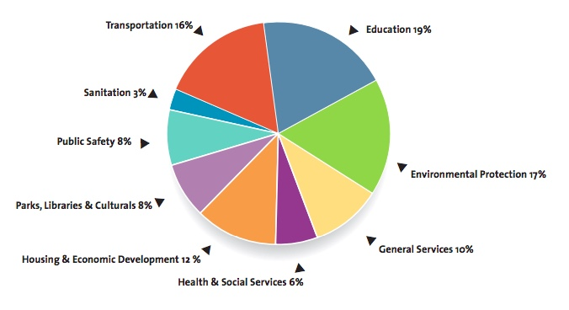
MMR –
Based on the
fiscal year
2017

Slide 6
SHORTCOMINGS -
The budget that they published does not match with the expenses occurred in the year 2017.
Example – Budget says 19% for education but a total of 28% has been spent on education.
The city’s constitutional debt limit, from the statement of debt affordability, is $90.2 billion in 2017 and $97.2 billion in 2018.
When we take the previous year’s debts, we were able to find that the debt increases every year. Comparing to the early 2000s, the debt right now is very high. The city has to figure out some solutions to pay off all the debts.
How the government is able to match with the expenses ?
Fact - Measure to make sure that you really are parked closer than 15 feet to the NYC fire hydrant. Investing in a $5 tape measure could save you $115 and the hassles of a NYC parking ticket.

Slide 7
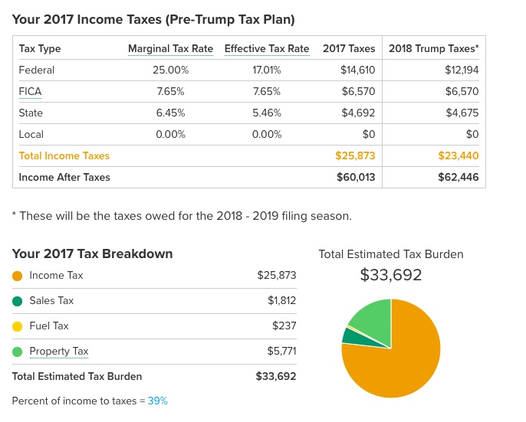
PRE-TRUMP TAX PLAN -
When we researched over the tax reports, we found that the taxes has been cut down in the past year. This is what they call as “Pre-trump Tax Plan”.

Slide 8
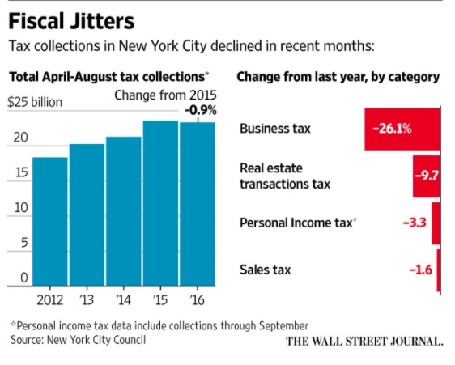
DECLINE -
The weakening in tax collections this year has particularly worried council budget officials and government watchdogs because of the sharp growth of the city’s budget since Mr. de Blasio, a Democrat, took office in 2014.
The budget has grown to about $82 billion from about $70 billion in 2014.
NYC also have to cover the tax differences to run the government. How ?

Slide 9
DATASET -
Source - NYPD’s dataset from the NYC OpenData repository & NYC’s Department of Finances.
We have both the datasets from Fiscal Year 2013 to Fiscal Year 2018 which comprises to approximately 5GB of textual data.
Our parking tickets dataset has approximately 54.6+M Records and 44 Attributes (FY 2013 to FY 2018) and similarly for the other set of dataset from Department of Finance.
NYC OpenData repository is the major source of information for our project.
This parking ticket dataset is real time data, which can pull up information from the NYC Open Data repository every last day of a month and store in the local storage system in CSV file format.

Slide 10
DATA CLEANING -
Since the data is dynamic, it requires data cleaning process all the time to correlate with the previously existing dataset.
This Data Cleaning includes removing unused attributes, replacing empty spaces with NULL, and make the attributes identical to the previous datasets. This Data Cleaning process also includes the Data Normalization.
This normalization of data is usually done manually by checking across the other datasets. Once all these granular updates are done, the nuclear datasets are now combined into a single molecular dataset.
DATA PROCESSING –
Processing the dataset is one important operation that has to be performed before using them in the application.
This process includes removing unnecessary data, version controlling and filling up the empty spaces and missing information.

Slide 11
GENERATING REAL TIME DATA -
Generating real-time data is usually done using Web Crawling and by running a CRON Job at the desired repository.
This both functionalities runs a periodic check on the database and look for any new information added.
To reduce the complexity of this operation, the CRON job is also setup in a way that it checks only with the specified naming conventions which will narrow down the search operation.
Once it finds a new data, it appends the data with the existing dataset in the local system and then to the HDFS.

Slide 12
ENVIRONMENT -
MAPPER FUNCTION -
MapReduce provides an effective environment to attain automatic parallelism. The MapReduce runtime system handles these internal low-level details to attain parallelism.
Map Tasks are used to split the input dataset into independent values. Each Cluster-node has a Job Tracker and a Task Tracker to take care of the data. Since the MapReduce operates exclusively on <Key, Value> pairs, we give the input in the same format.
The Key-value classes have to be serializable by the framework and hence we implemented the writable interface. The Key class have to implement Writable Comparable interface to enable the sorting feature.
Apache Organization suggests 82,000 maps for an input dataset with 10TB in size and 128MB block size. Also, the optimum level of parallelism for maps lies between 10 and 100. Thus number of maps that we used for this project is 11.

Slide 13
ENVIRONMENT -
REDUCER FUNCTION -
Reducer includes three primary phases: Shuffle, Sort and Reduce. We use the following method to perform the reducing operation reduce (WritableComparable, Iterator, Output Collector, Reporter).
The output is written in the File system using Output Collector . collect ( Writable Comparable, Writable).
The right number of reduces seems to be 0.95 or 1.75 multiplied by (<no. of nodes > * mapred . tasktracker . reduce . tasks . maximum).
Increasing the number of reduces increases the framework overhead, but increases load balancing and lowers the cost of failures.

Slide 14
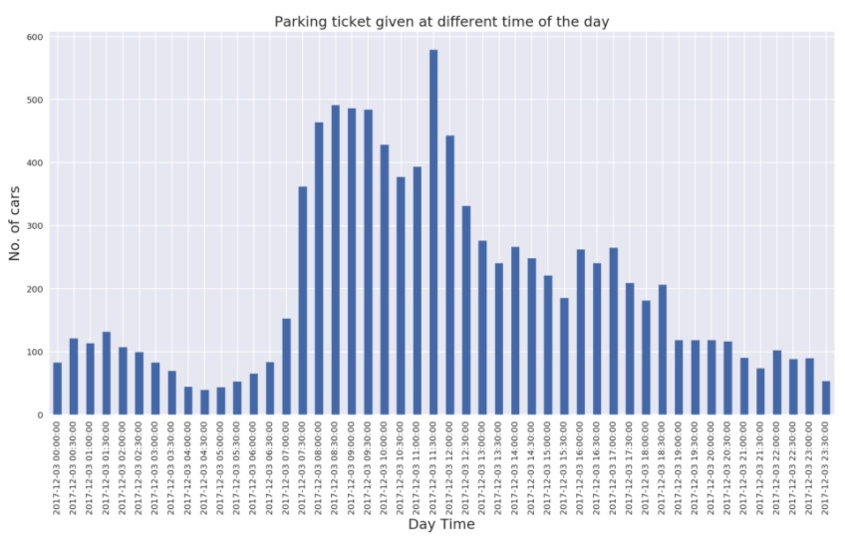

Slide 15
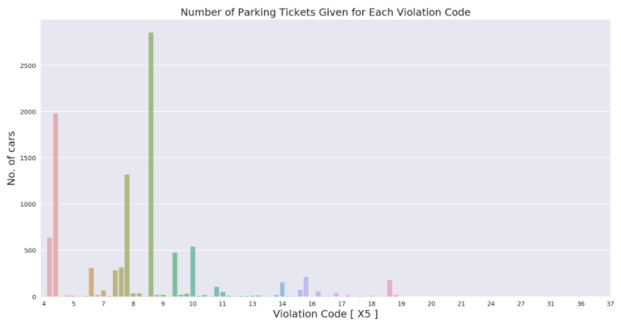
SPARK-
We use the core Spark APIs to operate on the data. We use the RDD API to process on the dataset. This API performs two different operations, Transformation and actions. We also use DataFrame API.
Spark is being the next generation of Hadoop which can process on realtime dataset but Hadoop lacks in processing the realtime dataset instead it can only process on static dataset and moreover to a fixed size.
If the dataset is larger than the limit of Hadoop, then it performs the batch operation and combines the result at the end.

Slide 16
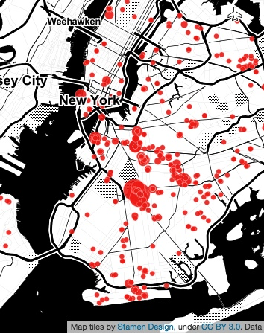
PIG LATIN -
We used Pig Latin to work on few operations because Hadoop can do only batch operations. To run a Pig script, we need to copy the files from local system to HDFS.
If the dataset is in some repository, we can import the dataset into the system using the “wget” which copies the dataset from a location using a static link. Then we need to start up the grunt interactive shell using the command “pig -x mapreduce”.
You can either run the entire Pig script using the exec function or input each line into the grunt interactive shell to analyze the JSON file.

Slide 17
BIG QUERY -
We used Google BigQuery to query on our datasets and do an analysis to find the way of approach for the project. For Example, We did a query to find the number of vehicles from each state that has been ticketed so that we were able to find the state that are being more concentrated on issuing the tickets. Google Bigquery allows to process millions of data in seconds.
In our case, it took approximately 50 to 60 seconds to process each query. We used one query and that is the final query to be executed to calculate the revenue generated. This particular query compares the value and updates in the dataset.
The dataset can be updated using the update query which uses the template of the dataset from the JSON File. The following query will make this update action.
bq update –schema UpdateSchema.json -t Project:Dataset.table

Slide 18
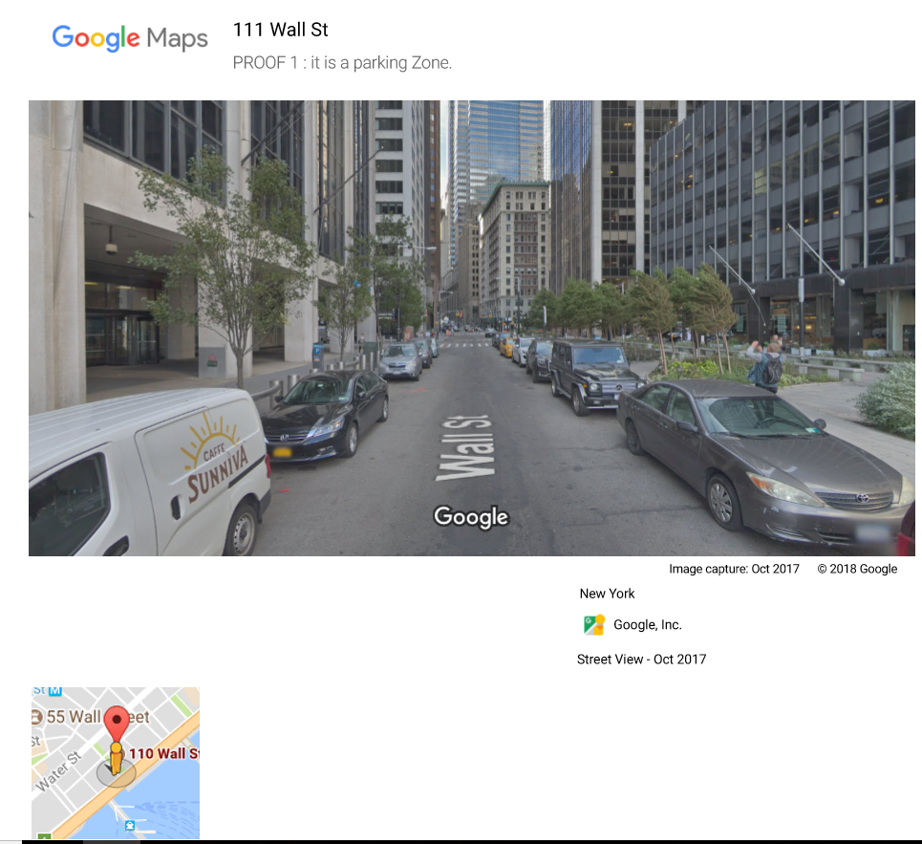

Slide 19
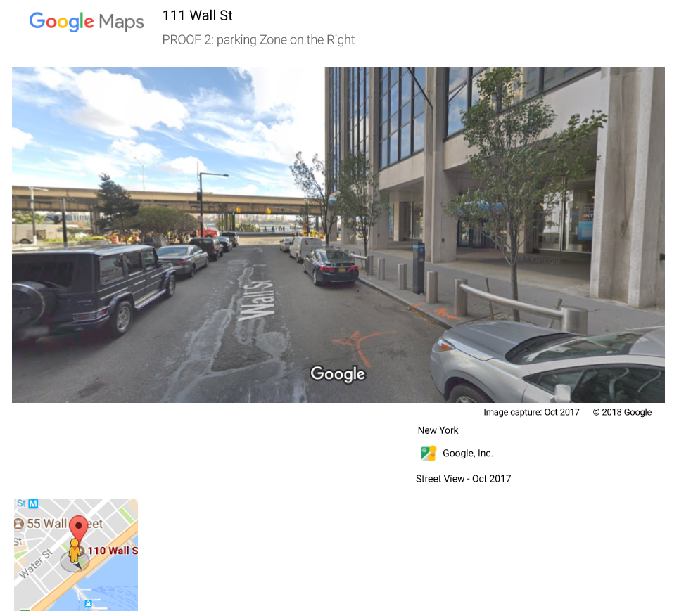

Slide 20
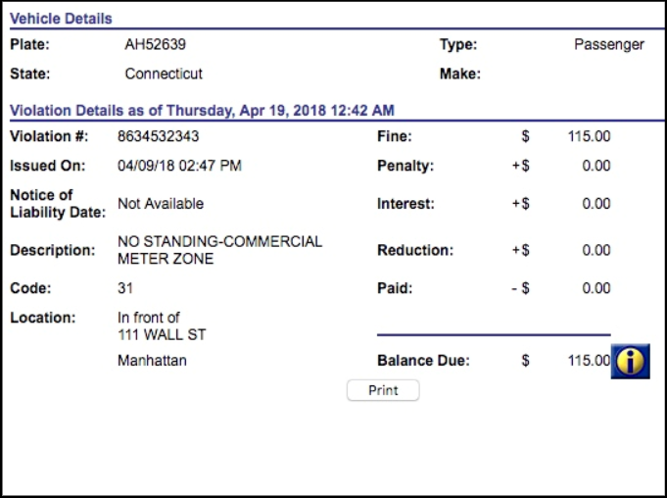

Slide 21
PERFORMANCE -
Apart from developing the application, we also concentrated on the security and performance of the system. Since we use the Hadoop environment, we created a VPN environment that keeps all the nodes inside a single private network.
All the nodes are managed from gateway and Https enabled Domain Name Server(DNS). This service is provided by CloudFlare.
We make use of the CloudFlare system and integrated with our machines that are hosted in Google Cloud Platform and Amazon Web Services(AWS).
We experienced an optimal latency time for every operation that we do on the dataset. Performance of the system went down when multiple operations are done simultaneously.

Slide 22
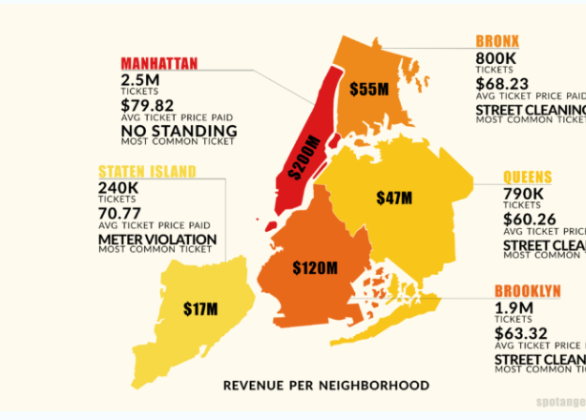
CONCLUSION -
In our project we were able to find the total amount the government is making from the parking tickets and other such violations.
As per our calculation, the government is making approximately $993M in the year 2016 and it has been increased to $1.9B in the year 2017.

